Slide 1
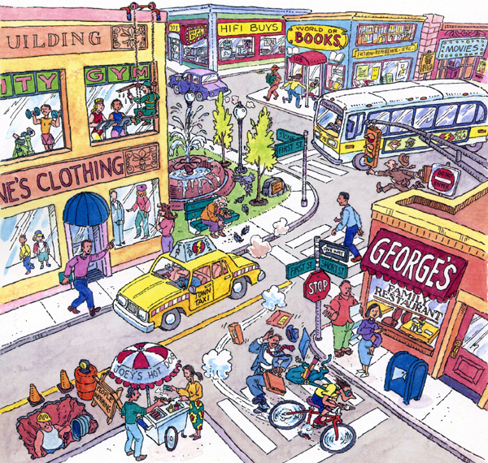

Slide 2
Create a Character History
Where does your character come from?
Where does he/she live? With whom?
What does your character like to do?
What does your character do for a living? Where do they work?
Who does he/she like? What have they done about it? What is the situation now?
What struggles has your character faced in life?
What has your character lost?
What crisis is your character currently facing?
What brings your character to this particular point?
What is going through their mind right now?

Slide 3
Create an Action based story
What senses could you be experiencing?
What action words could go with those words?
What is the level of urgency? (slow, easy-going, fast, moderate)
What words could go with those movements?
What is happening in the body?
How are other things reacting around the person?
What thoughts race in their heads right now.
Now write a paragraph (quickly), trying to encapsulate the essence of the moment, combining history, actions and senses together)

