Slide 1
ZONES INFORMATION
KLO TEAM

Slide 2
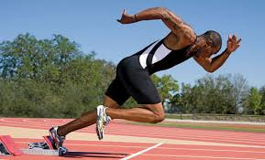
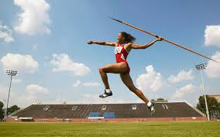
EVENTS
Everyone’s events are finalized. Plan to be early to each event for check-in.
Leave plenty of time for proper warm-up.
Adopt a buddy system to keep you aware and moving.
Do not make decisions for yourselves about events, just go to them. Your coaches have done more than 30 hours of work to place you in your event. Your job is to show up to the event and do your best and have fun doing it. Missing vreates real headaches for organizers.
Be sure to stay for relays, a whole team will be depending on you and spares are sparse. Do not make plans to leave early.
You will get your number when you get to the track.

Slide 3
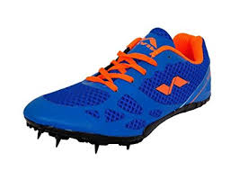
Gear
I will begin handing out Jerseys at about 8:30 am, unless I am a bit late. Numbers will already be assigned.
If you have not been handing in your jersey, you better have it with you. There are no extras
SPIKES (2 new pairs now – 8.5 mens and 8 woman to help with the need). Spikes will be by the High Jump area. Sign out and immediately return them after your event. NEVER walk onto the concrete with them. Take them off and walk with them in your hand. Or go the long way around from the finish line. STRICT SIGNOUT PROCEDURES. All transactions must be tracked so don’t just hand them off and forget to write it down.
In relays, be prepared to share them. If you record, a higher grade can look for you and grab them when you are done.
RETURN YOUR JERSEY BEFORE LEAVING FOR THE DAY!!!!!!!!!! Bin at High Jump.

Slide 4
Your Responsibilities
Act Respectfully
Don’t talk to people running events
Stay completely away from the finish line and roped off areas
Stay 2 metres away from the edge of the track if not actually on it.
Be where you need to be. Check the schedule and time frequently.
Stay completely off the grass unless retrieving the javelin.
HELP. Especially if you don’t have an event before 11 you should be helping me set up the High Jump area
Be at High jump for your numbers and a warmup at 9:30
Sign out your shoes ALWAYS, and return promptly. ALWAYS SOMEONE NEEDS TO HELP WITH SIGNOUT AND RETURNS. PLEASE DO A SHIFT IF YOU ARE NOT THAT BUSY.
Help at day’s end with High jump packup. Don’t wander away when work needs to get done.
Stay Hydrated.
Get back on the bus at 5pm or tell me you are leaving.

Slide 5
PEAK PERFORMANCE
Have a high carb meal Monday night (PASTA, POTATOES)
Eat a reasonable healthy breakfast in the morning, do not skip this.
Drink lots of water MONDAY and continue in the morning and through the day. Hydration is key to optimal performance
Have healthy food to eat through the day. Fruit, granola bars, sandwiches, crackers, fruit juice, etc.
DO NOT have Slurpees, monster drinks, candy, pizza, etc. This will only make you sick and perform poorly.
STAY OUT OF THE SUN. It saps your strength. No sun tanning and find cover at all times. SUNSCREEN OFTEN
Sunglasses and a hat a must.
If you are at an event, LEAVE YOUR PHONE WITH A FRIEND. You don’t need the distractions.

Slide 6
PEAK PERFORMANCE (con’t)
Push yourself…That being said, distance runners, push yourselves only as hard as you need to, to preserve your placing. It is a long day going your fastest every time. Be aware who you are competing against. (Penn Hi and Summerland NOT IN OUR ZONE) Check you are not trying to beat another division, it won’t matter in the rankings.
Push through all finish lines as there may be many heats and you only run once.
PRACTICE WITH YOUR RELAY TEAM, pass at speed.
Results will be posted near the entrance, don’t ask anyone about what you are at during the event.
Bring a water bottle and keep it full.
STRETCH AND COOL DOWN AFTER AN EVENT. Light jog. Stretch.

Slide 7
Enjoy Your Hard Work!
Enjoy the day!! Take pictures! Cheer on your teammates! Be there for each other and the team! Build friendships! You all deserve a wonderful day!
NOTE: I will bring things like watermelon, pineapple, granola bars, bagels, cream cheese, etc. But don’t depend solely on that.

