Slide 1
DREAM VACATION!!
BY:

Slide 2
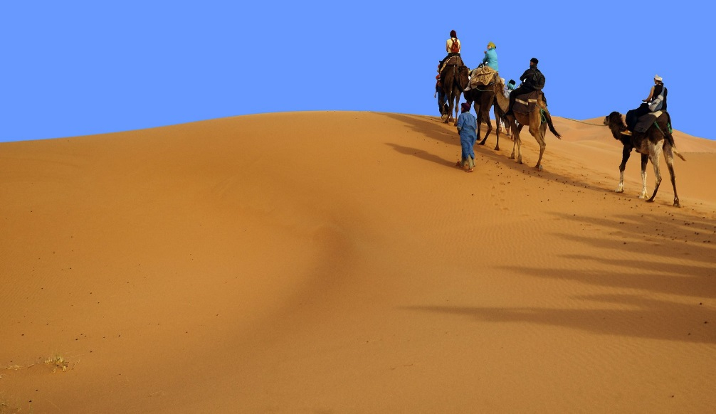
DESTINATION
Stats
Latitude:
Longitude:
Time Difference:
Elevation:
Bearing from last dest.:
Date of travel:

Slide 3
What you are doing here – description and photo montage/videos/music
MY TOUR GUIDE

Slide 4
Be sure to fill out all your days with activities, though hanging and snorkeling or window shopping/hanging out can fill a few of them. Video example here. To insert video go to Insert/media/video and best to put it in not linked by ripping with 5k video.

Slide 5
DESTINATION
Stats
Latitude:
Longitude:
Time Difference:
Elevation:
Bearing from last dest.:
Date of travel:

