Slide 1
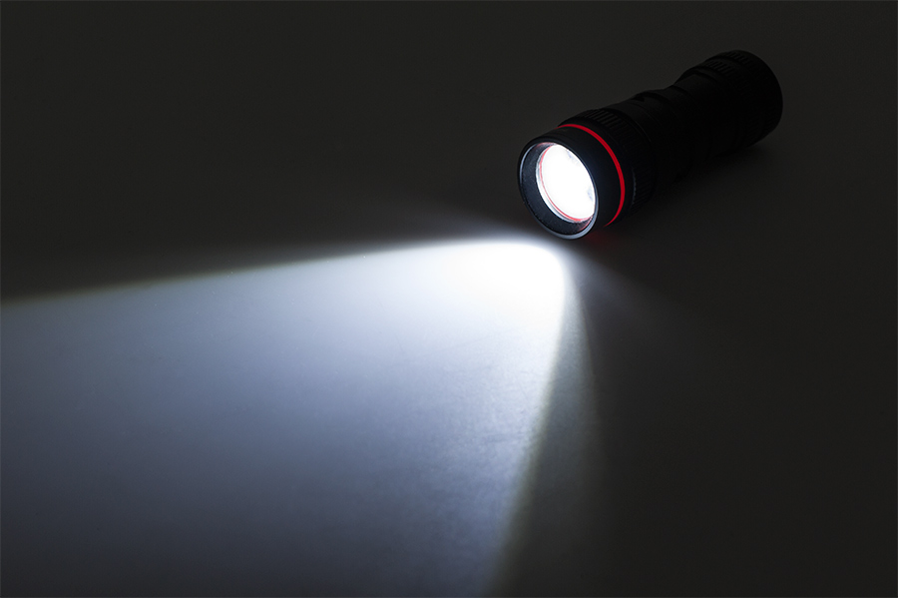
Good decisions hold up when the light shines upon them.

Slide 2
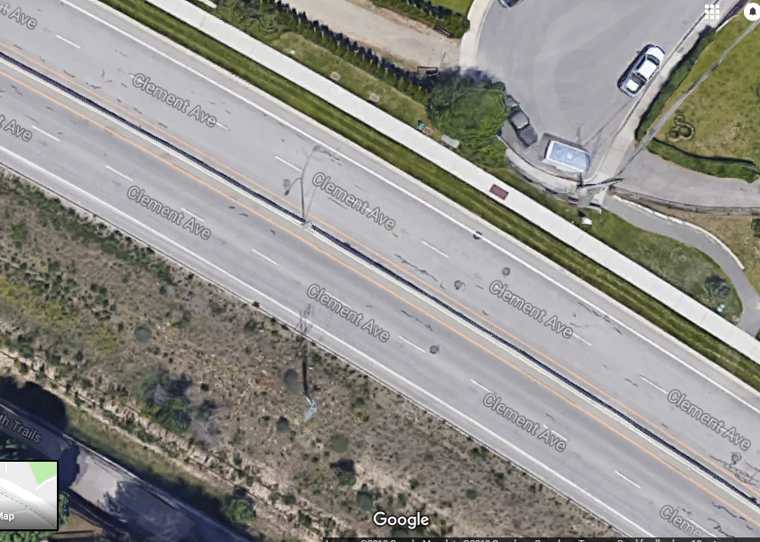
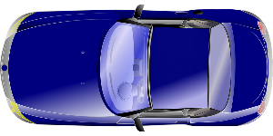

Slide 3
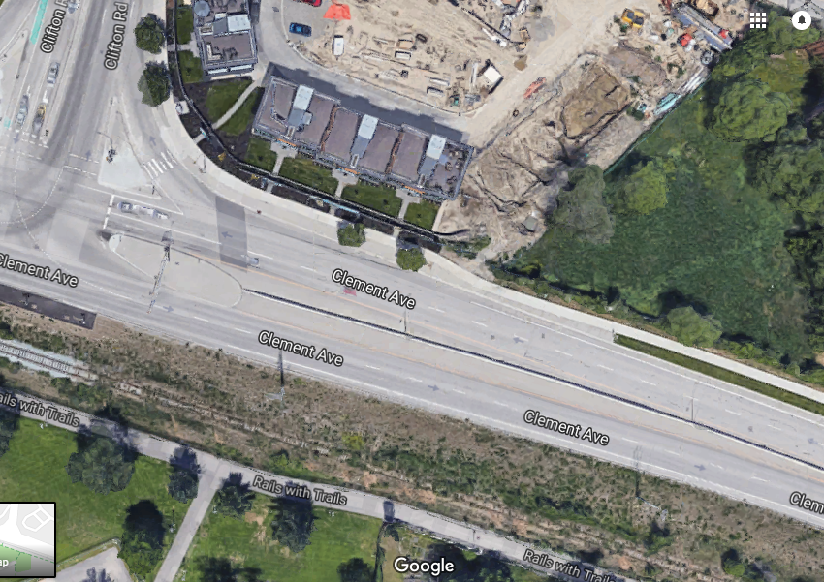

Slide 4
Her decision didn’t hold up to the light
Why was such a bad decision made?
- Fear paralysed her brain?
She thought if she just kept going it would work out?
She was too afraid to turn around?
Does that ever happen to you?

Slide 5
So how do we make good decisions? 2 things
Change your perspective, if you haven’t already, to critically see yourself as a player in a story where you are not always the center:
Go from “I am” or “I have”
e.g. I am a hockey player, I have 2 sisters, I have 2 good friends
To the opposite “Am I?” or “Have I”
e.g. Am I a good teammate or friend? Have I shown my sisters how they should expect to be treated by a partner? Have I lived up to my responsibilities as a son, daughter? (have you ever thought what those might be?). Have I honored others’ journeys today?

Slide 7
2nd thing to making good decisions
Be true to your light – Be honest to those around you
Never play small
Never be afraid of who you can be, what you can accomplish
Never let your fear get in the way of what you need to do, even if, or maybe especially if, it goes against popular opinion.
What is lost when we do things to fit in, or to not stand out? Who do we become?

Slide 8
A candle can be seen from 2.5 km away
Darkness can’t be seen at all

