Slide 1
TRI - Writes
Instructions:
You will write the intro in one story, the rising action in another and the conclusion in another. 15 minutes per write. new will select the 3.

Slide 3
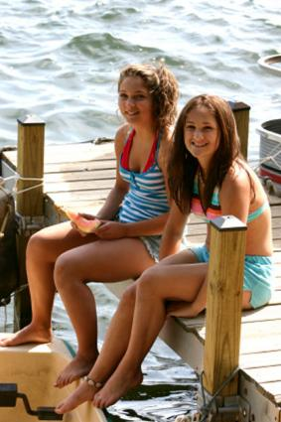

Slide 4
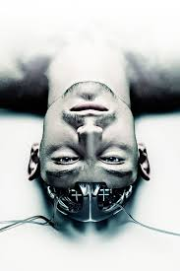

Slide 5
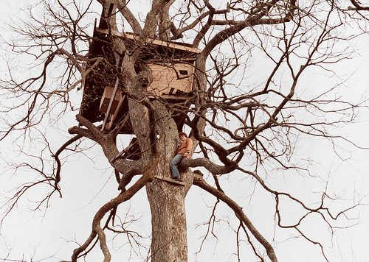

Slide 6
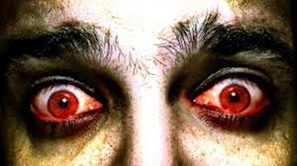

Slide 7
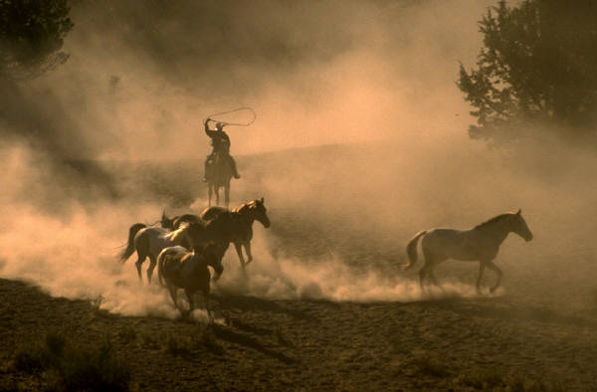

Slide 8
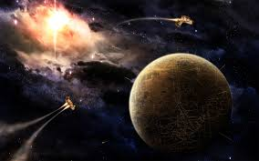

Slide 9
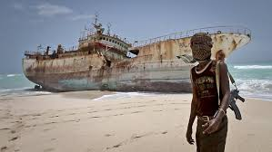

Slide 10
