Slide 1

JAN - MARCH

Slide 2
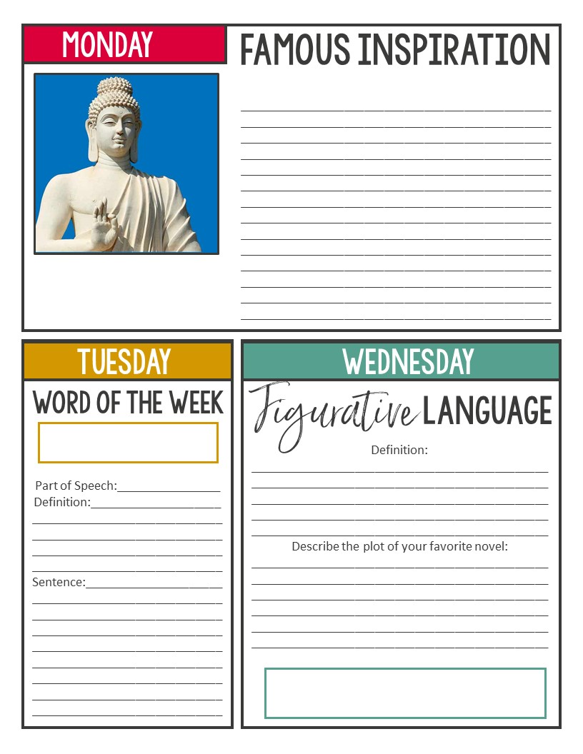
JAN 8-JAN 19 – Mostly do the day of the week that corresponds
Read and respond to the quote. Do you agree or disagree with the quote? How can the quote relate to or impact YOUR life?
“Health is the greatest gift, contentment the greatest wealth, faithfulness the best relationship.” –Buddha
precocious
Plot structure

Slide 3
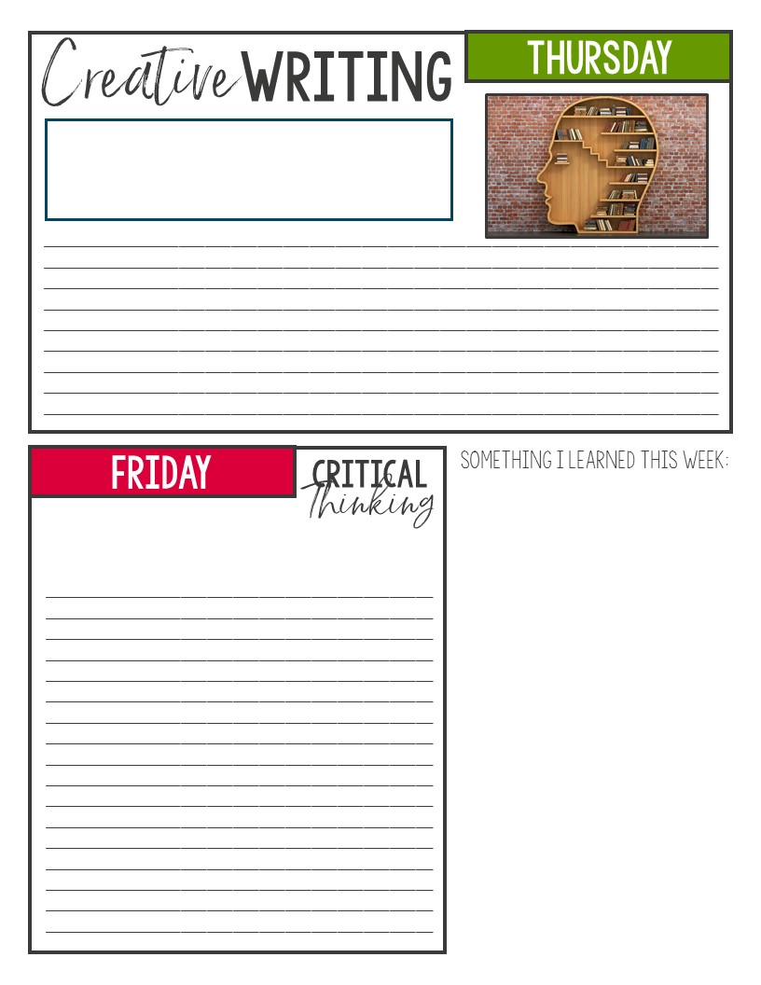
JAN 8-JAN 19 – Mostly do the day of the week that corresponds
Create the script for a commercial for your favorite brand of food. Be sure to include ALL elements of a proper script.
Which super power would you most like to have? Explain your reasoning below.

Slide 4
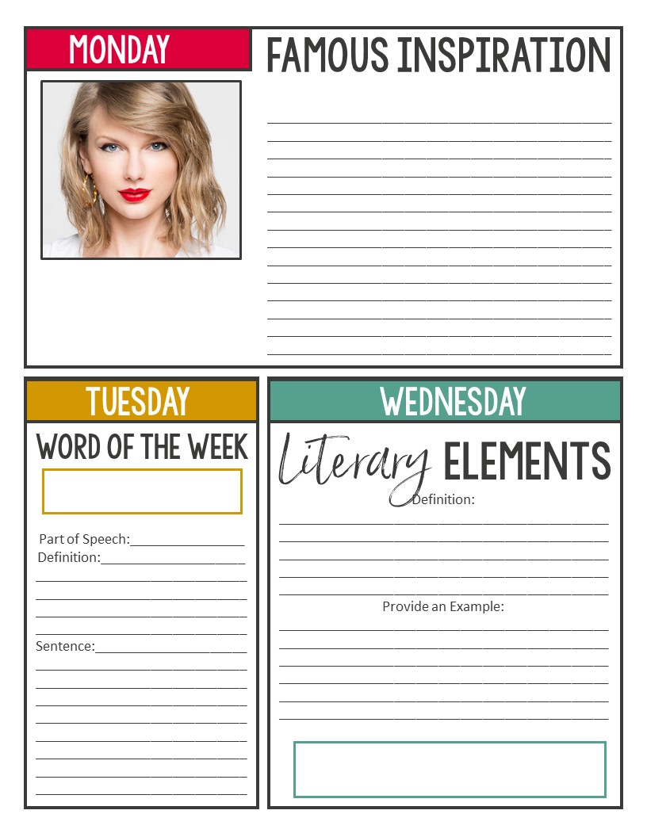
JAN 22-FEB 3 – Mostly do the day of the week that corresponds
Read and respond to the quote. Do you agree or disagree with the quote? How can the quote relate to or impact YOUR life?
“Red is such an interesting color to correlate with emotion, because it's on both ends of the spectrum. On one end you have happiness, falling in love, infatuation with someone, passion, all that. On the other end, you've got obsession, jealousy, danger, fear, anger and frustration.” –Taylor Swift
indolent
conflict

Slide 5
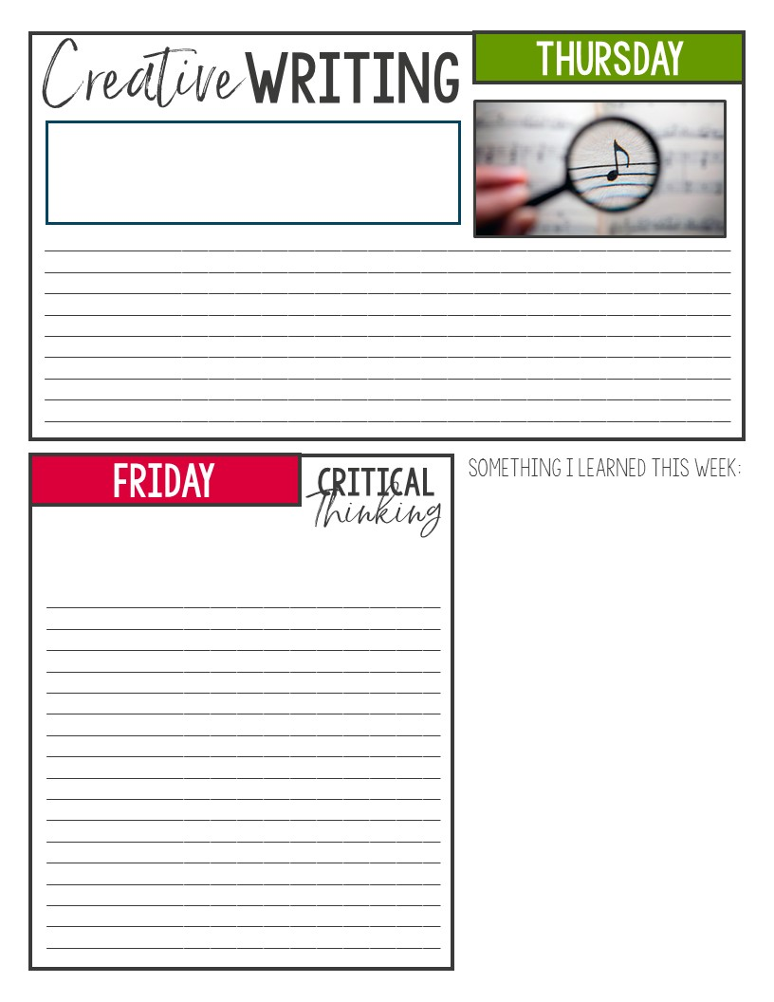
JAN 22-FEB 3 – Mostly do the day of the week that corresponds
Create song lyrics about/for the last person you talked to.
Create a UTOPIAN society (the IDEAL society of perfection). What would it look like, where would it be, what would be different than society today?

Slide 6
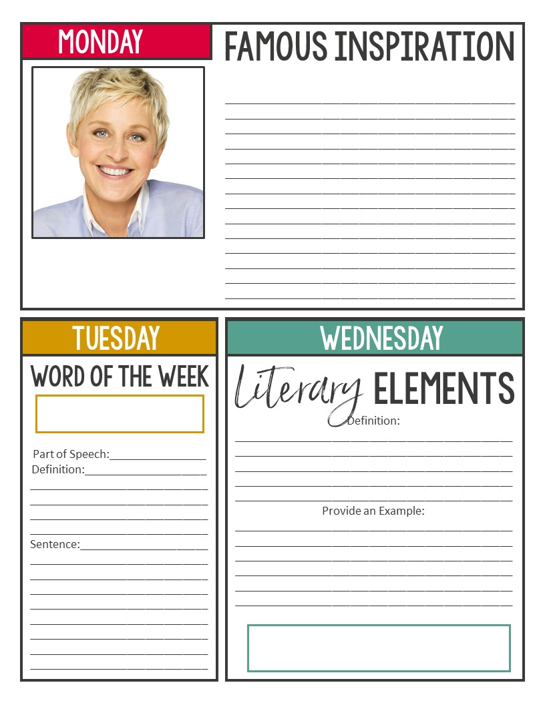
FEB 5 – FEB 19 Mostly do the day of the week that corresponds
Read and respond to the quote. Do you agree or disagree with the quote? How can the quote relate to or impact YOUR life?
Here are the values that I stand for: honesty, equality, kindness, compassion, treating people the way you want to be treated and helping those in need. To me, those are traditional values.” –Ellen DeGeneres
nefarious
CONFLICT: person vs self

Slide 7
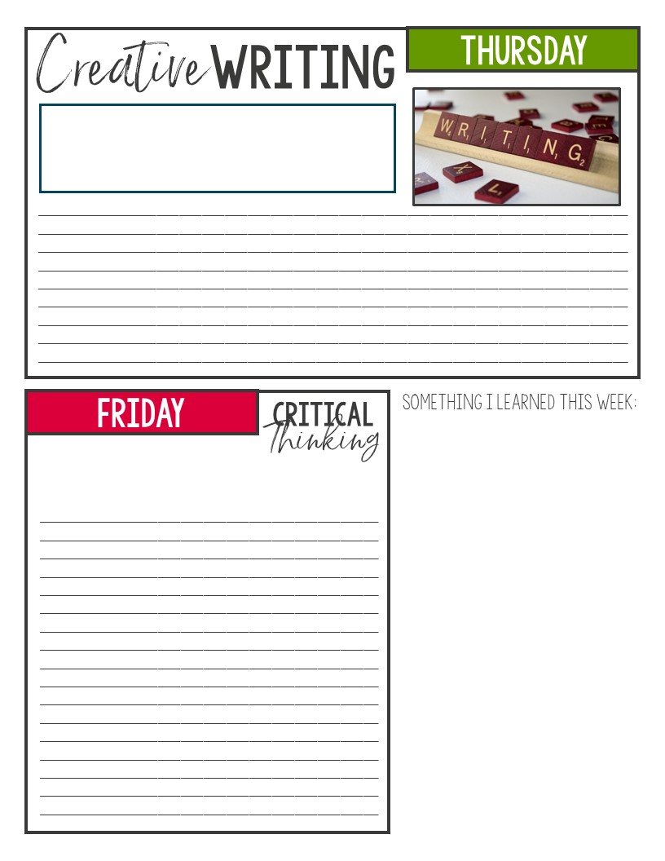
FEB 5 – FEB 19 Mostly do the day of the week that corresponds
FREE WRITE: write about anything you want. This needs to be at least 1 full page. **Be sure to keep it school appropriate.
Create a DYSTOPIAN society. What would it look like, what would be different from today’s society?

Slide 8
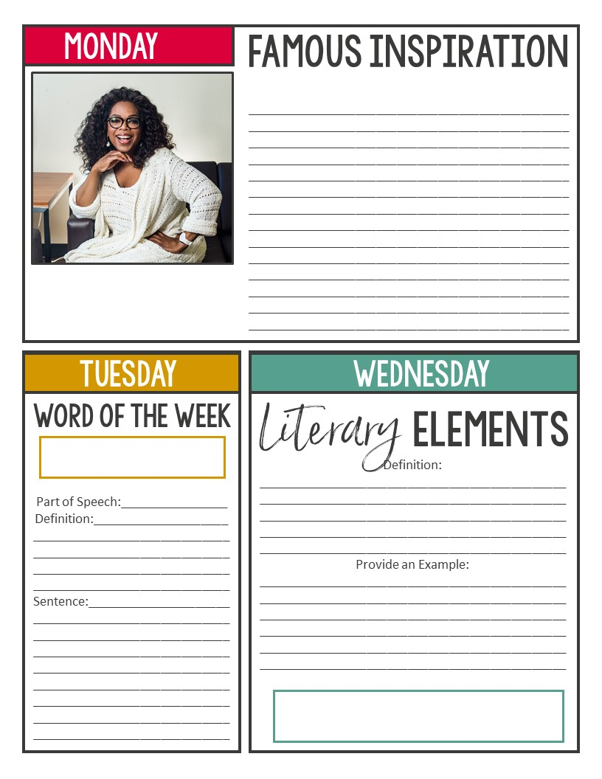
FEB 21 – MARCH - Mostly do the day of the week that corresponds
Read and respond to the quote. Do you agree or disagree with the quote? How can the quote relate to or impact YOUR life?
Be thankful for what you have; you'll end up having more. If you concentrate on what you don't have, you will never, ever have enough.” –Oprah Winfrey
paradigm
Conflict: person vs self

Slide 9
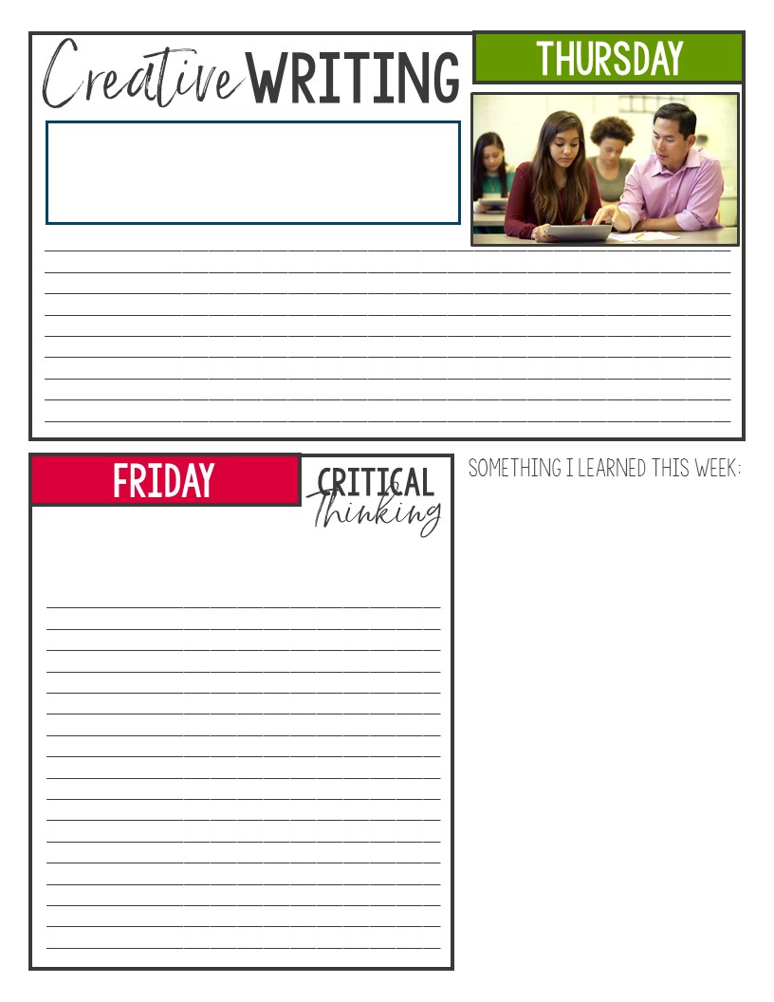
Finish the sentence: “I wish my teacher knew…” and explain WHY you wished they knew these things about you.
Think of a popular controversial topic that exists today. What is your solution? Be detailed!

